Slide 1
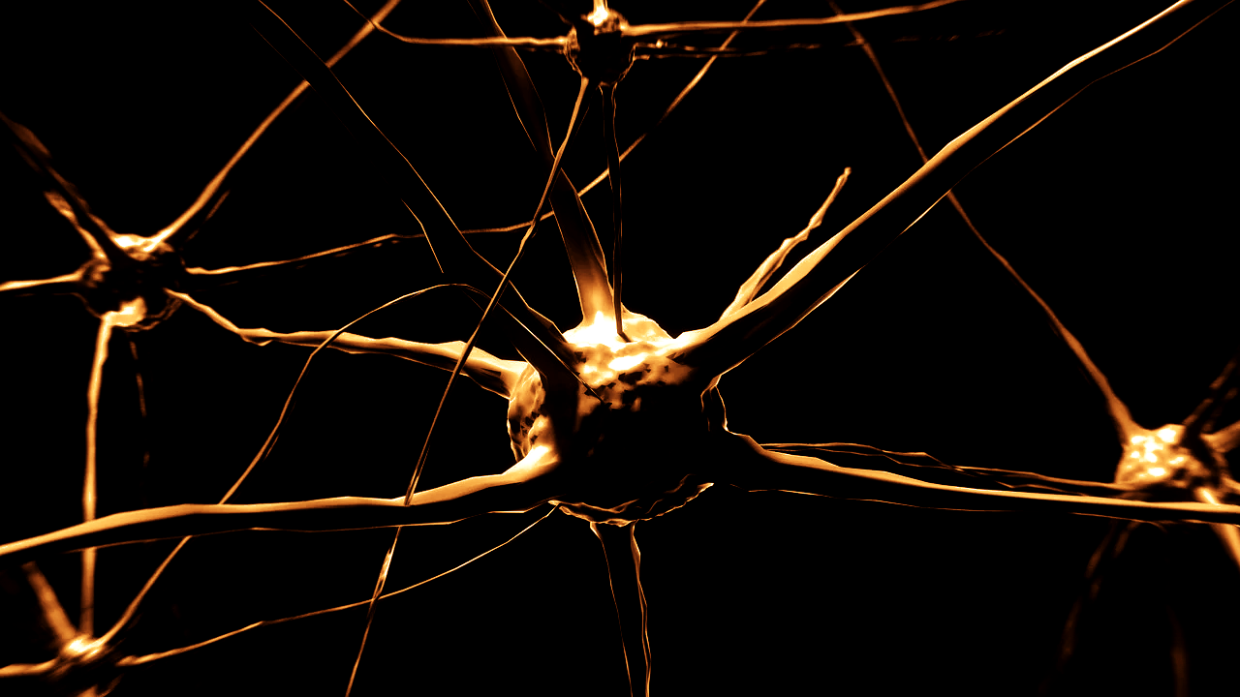
What is Unsupervised Learning?

Slide 2
Applications
Recommend purchases or videos
Group customers based on attributes
Genetic and species grouping
Distinguish different kinds of tissues

Slide 3
Applications
Make a customer persona
Will this customer buy Item B if they bought Item A?
Detect bot activity

Slide 4
Applications
Recognize handwriting
Recognize speech
Create speech
Tag parts of speech
Translate text

Slide 5
Machine Learning:
Supervised Learning
Unsupervised Learning
Reinforcement Learning

Slide 6
Supervised Learning
Type of machine learning
Learns a function to map an input to an output
Uses sample input-output pairs

Slide 7
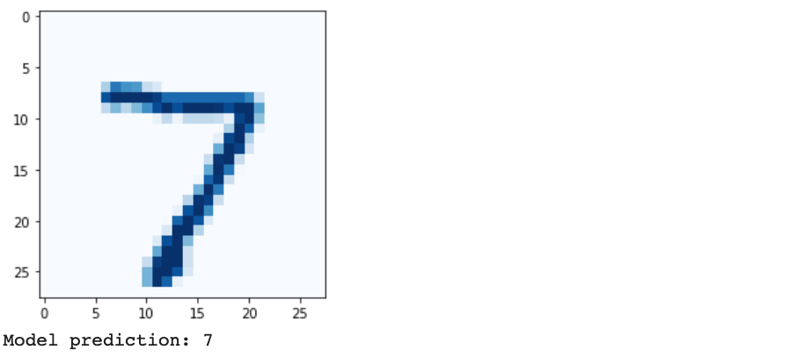
Unsupervised Learning
Type of machine learning
Looks for new patterns in data with no pre-existing labels
Minimal human supervision

Slide 8
Unsupervised Learning
Principal component analysis
Cluster analysis

Slide 9
Principal component 1
Feature 2
Principal component 2
Feature 1

Slide 10
Principal component
analysis
Data is noisy
Dimensionality reduction
Get each data point’s first few important components

Slide 11
Principal component analysis
Get each data point’s first few important components
Creates lower-dimensional data
Preserves as much of the data's variation as possible

Slide 12
Cluster Analysis

Slide 13
Cluster Analysis
finds commonalities in data
reacts based on presence or absence of the commonalities in every new input
helps detect data points that do not fit into any group

Slide 14
What is Unsupervised Learning? ✓

